Slide 1

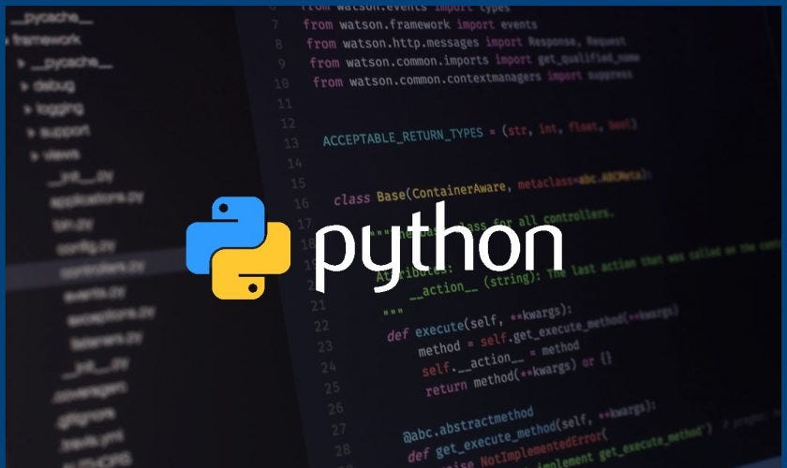

Python Bootcamp For Beginners

Slide 2

Introduction
Lesson 2
Introduction
Recap of last lesson
Setup Coding environment
Install VS Code
Add Python 3 to VS Code
Setup GitHub Account
Setup Git Repository
Install Git
Clone GitHub Repository
Setup GitHub Local folder
Clone GitHub Repository to Local Brach
Coding Exercises
Hello World
Print Your name
Add 2 Numbers
Print “Python is awesome”
Print “Python is awesome” - where each word is stored in a different variable
Find the Average of numbers
Errors
Syntax
Logical
Runtime

Slide 3
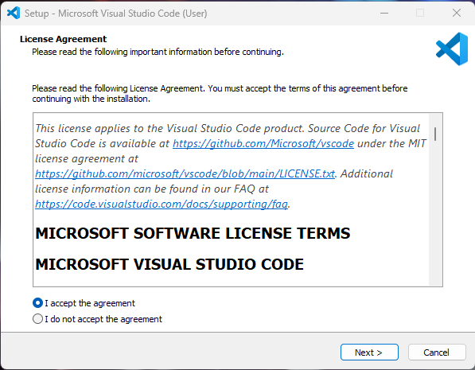
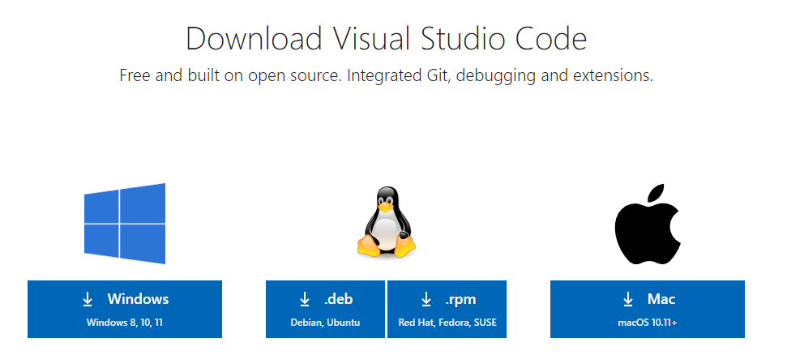
Setup Coding environment
Lesson 2
Installation of VS Code
Visual Studio Code, commonly known as VS Code, is a free and open-source code editor developed by Microsoft. It is available on Windows, macOS, and Linux operating systems.
Step 1 : Go to -
https://code.visualstudio.com/download
Step 2 :
Download the Visual Studio Code installer for Windows. Once it is downloaded, run the installer. Then, run the file – it will only take a minute.
Step 3 :
Accept the agreement and click “next.”

Slide 4
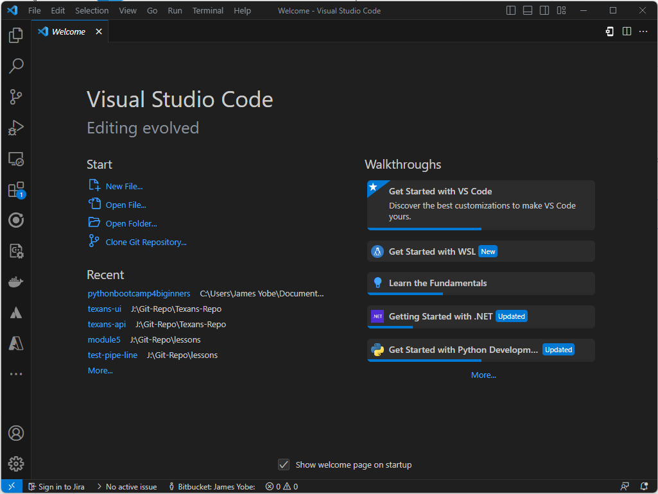
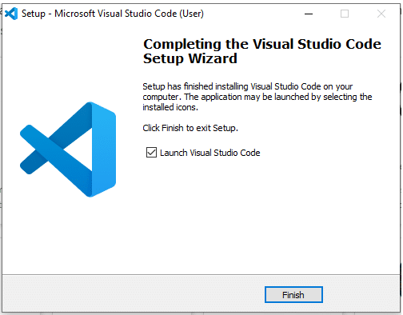
Setup Coding environment
Lesson 2
Step 4 :
After accepting all the requests press finish button. By default, VS Code installs under: "C:\users{username}\AppData\Local\Programs\Microsoft VS Code."
Step 5 :
Congratulation!! You have successfully installed VSCode

Slide 5
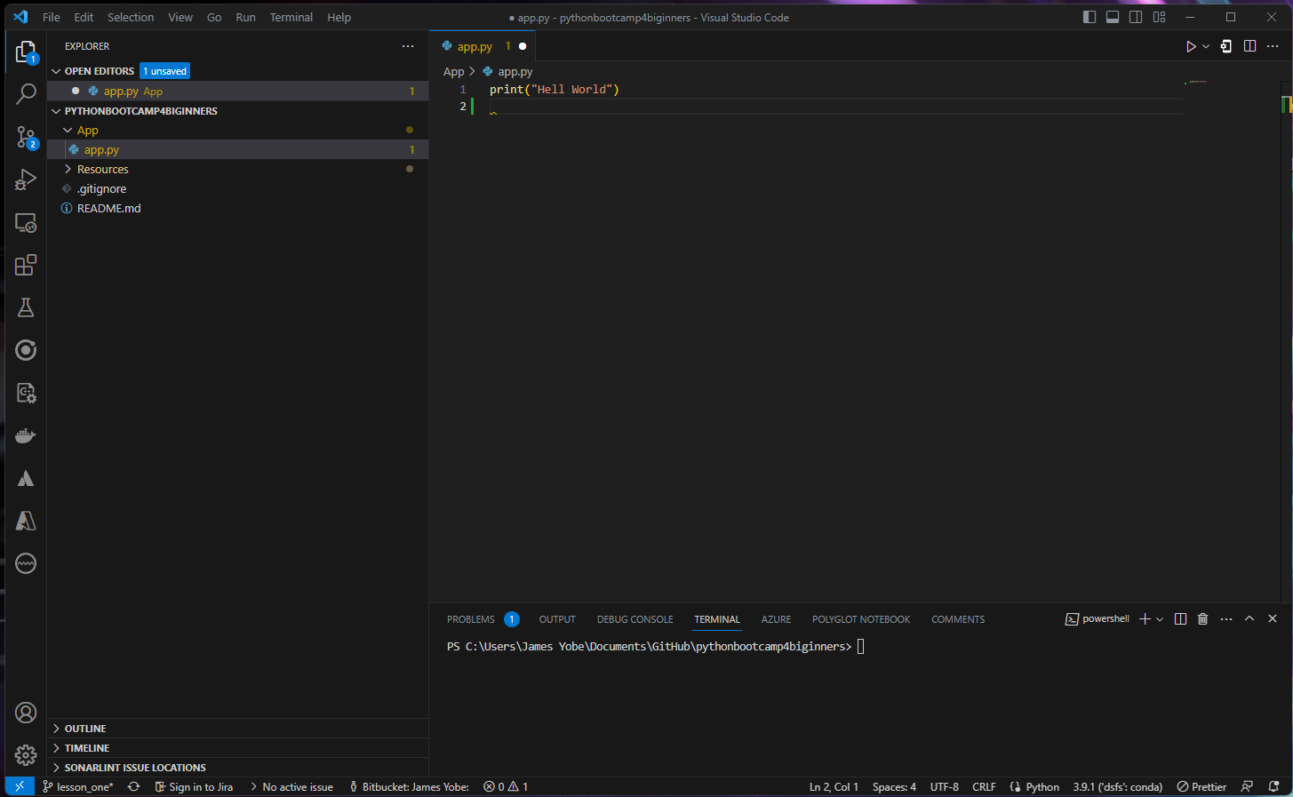
Setup Coding environment
Lesson 2
VS Code Interface
Menu
File Explorer
Run Button
Search
Source Control
Coding Environment
Folder
Files
Account
Terminal

Slide 6
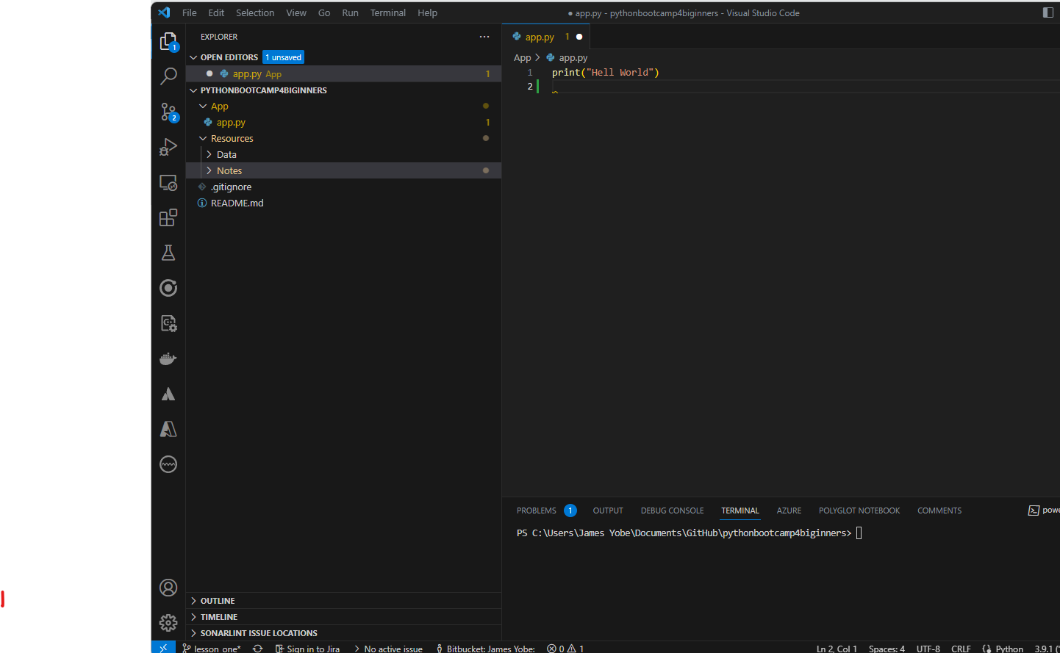
Setup Coding environment
Lesson 2
Bootcamp File structure
Folder
Python Code
Resources
Data Files
Class Notes
Lesson(Branch)

Slide 7
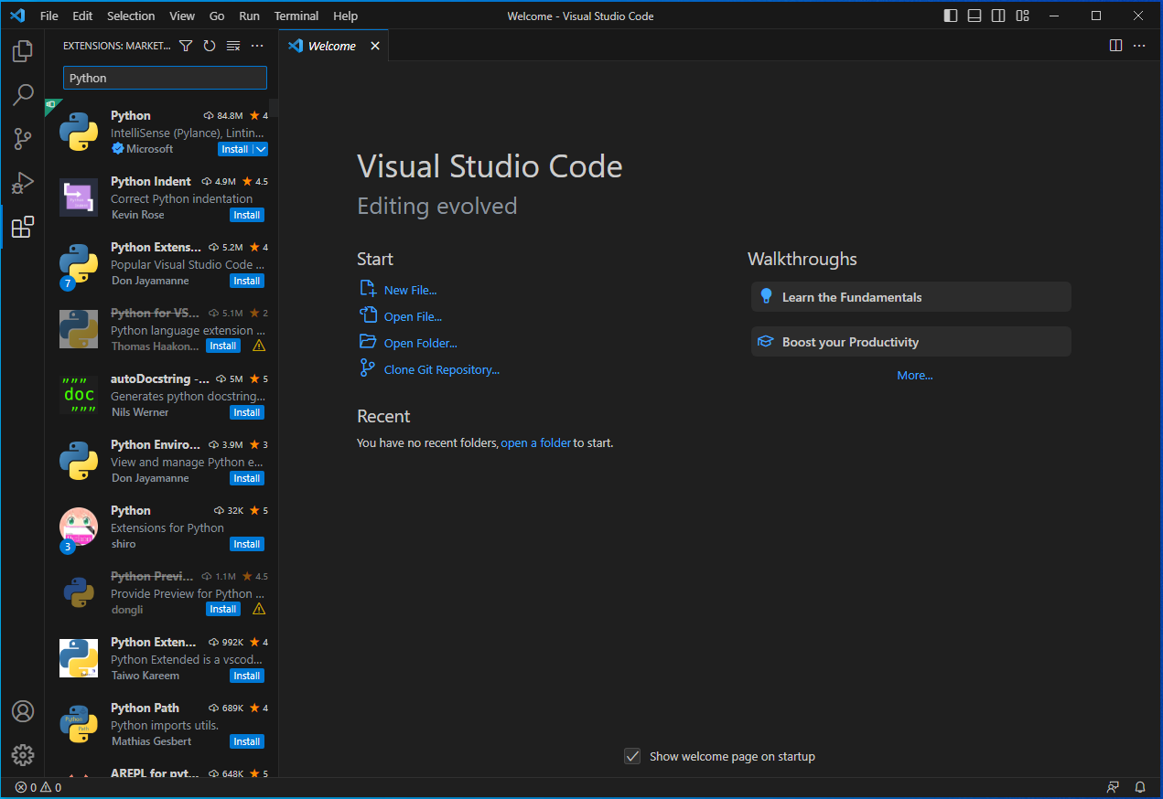
Setup Coding environment
Lesson 2
Add Python 3 to VS Code
Step 1:
Open VS Code
Step 2:
Search for Python
Step 3:
Click Install

Slide 8
Setup Coding environment
Lesson 2
Add Python 3 to VS Code
Step 1:
Open VS Code
Step 2:
Search for Python
Step 3:
Click Install

Slide 9
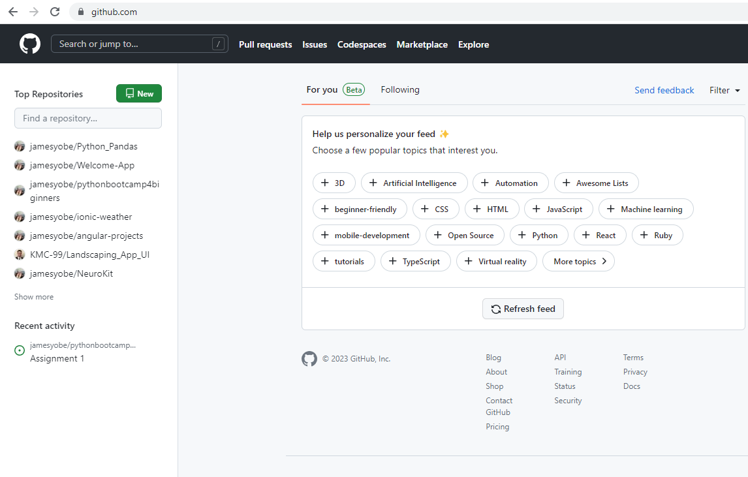
Introduction to GitHub
Lesson 2
What is GitHub
GitHub is a web-based platform that serves as a hub for software development collaboration. It is a Git repository hosting service, which means that it provides a place for developers to store and manage their code, track changes to that code over time, and collaborate with others on those changes.
GitHub offers a range of features, including version control, issue tracking, project management tools, and social networking features. It allows developers to work on projects in a distributed fashion, as multiple people can access and work on the same codebase simultaneously

Slide 10

Introduction to GitHub
Lesson 2
Setup GitHub Account
Step 1 : Go to
https://github.com/
Step 2 : Click Sign up

Slide 11
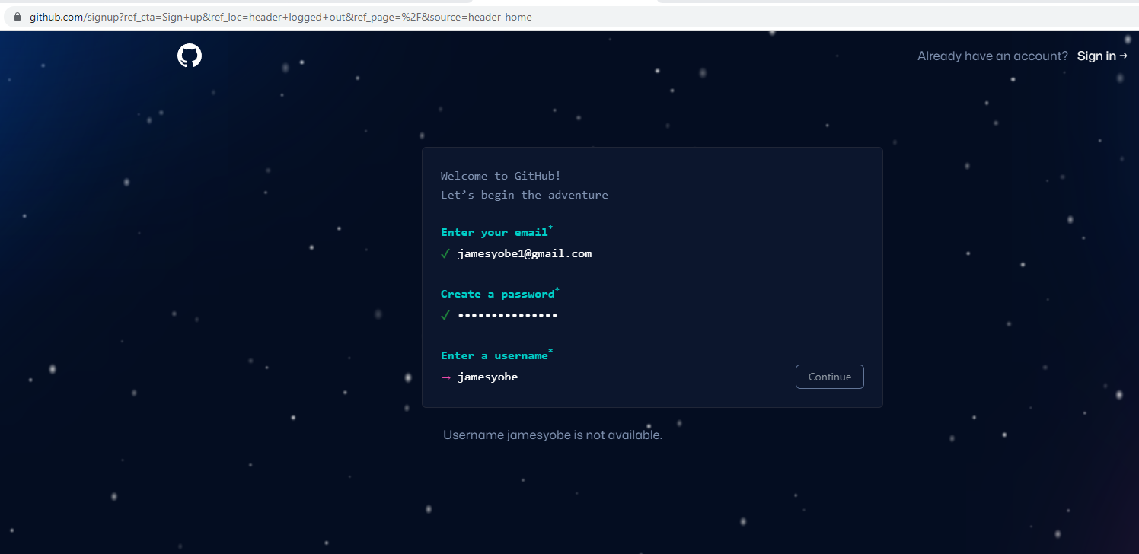
Introduction to GitHub
Lesson 2
Setup GitHub Account
Step 3 : Enter email
Step 4 : Enter Password
Step 5 : Enter Username

Slide 12
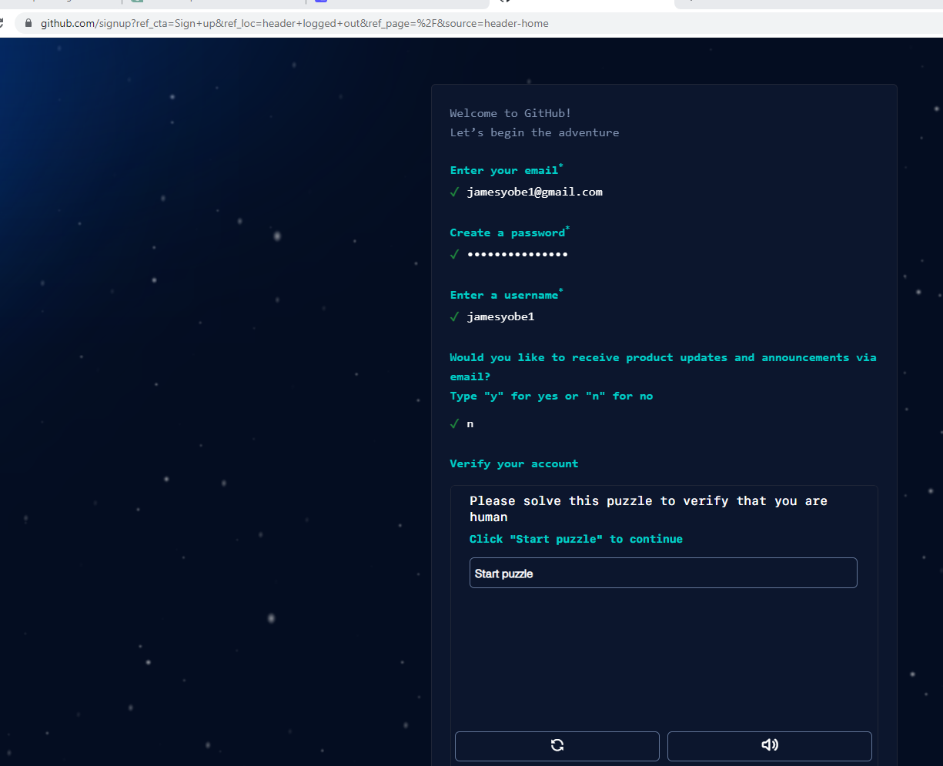
Introduction to GitHub
Lesson 2
Setup GitHub Account
Step 6 : receive updates
y/n
Step 7 : Verify Account
Click Start Puzzle

Slide 13
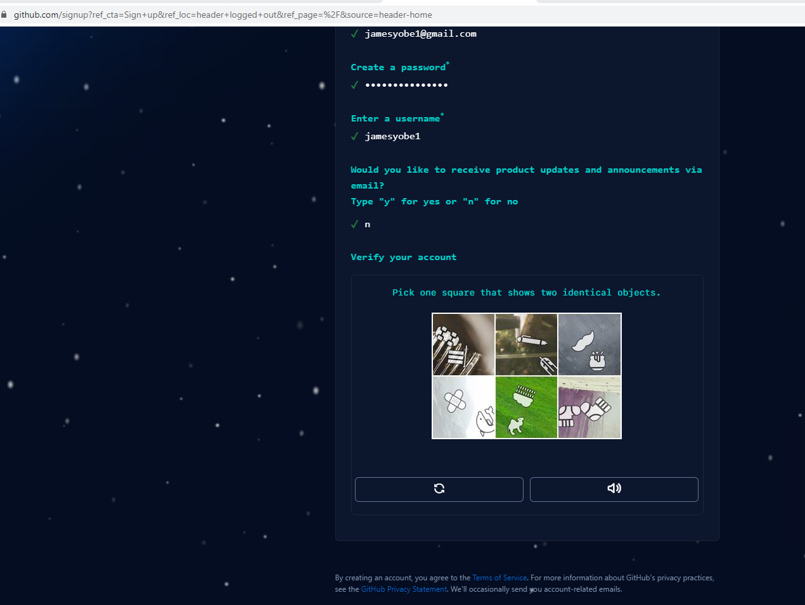
Introduction to GitHub
Lesson 2
Setup GitHub Account
Step 8 : Solve puzzle
Step 9 : Click Create Account after solving puzzles

Slide 14
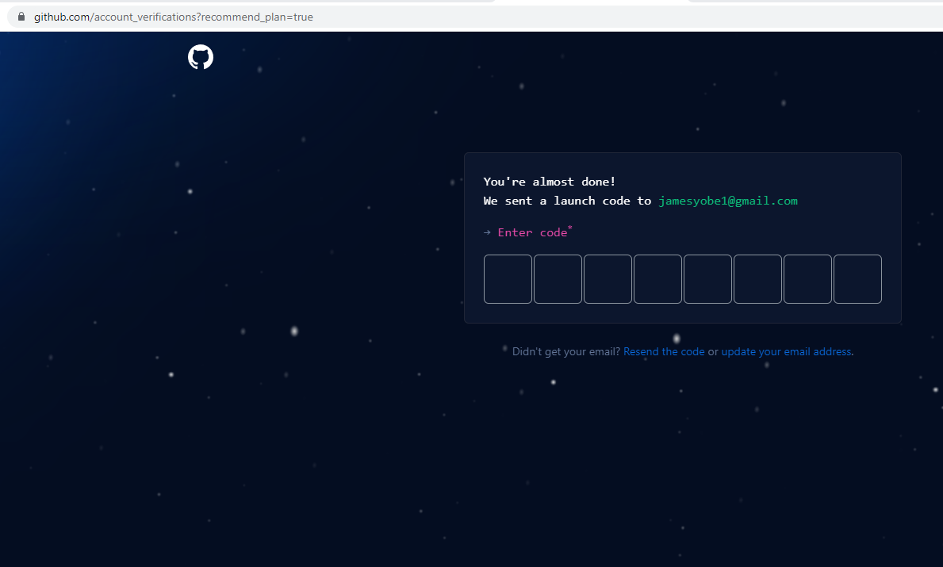
Introduction to GitHub
Lesson 2
Setup GitHub Account
Step 10 : Enter code sent to your email

Slide 15
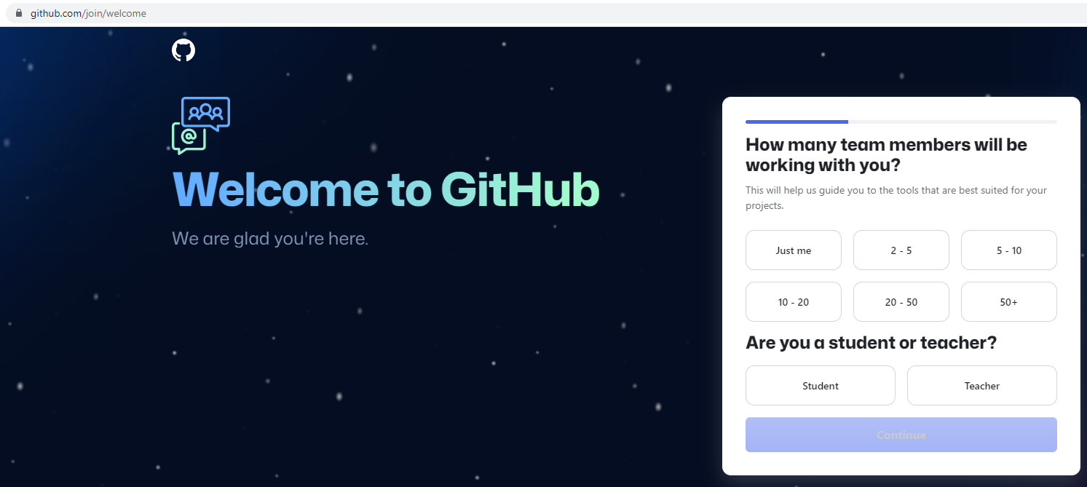
Introduction to GitHub
Lesson 2
Setup GitHub Account
Step 11 : Select Just Me
Step 12 : On next window click continue
Don’t select any options

Slide 16

Introduction to GitHub
Lesson 2
Setup GitHub Account
Step 13: Continue for free

Slide 17
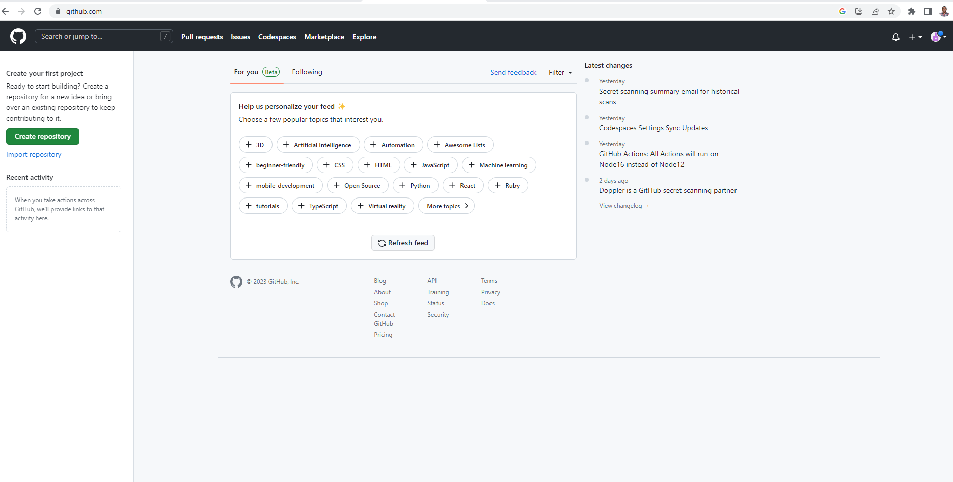
Introduction to GitHub
Lesson 2
Setup GitHub Account
Step 14: Congratulations!! You have successfully setup a GitHub Account

Slide 18
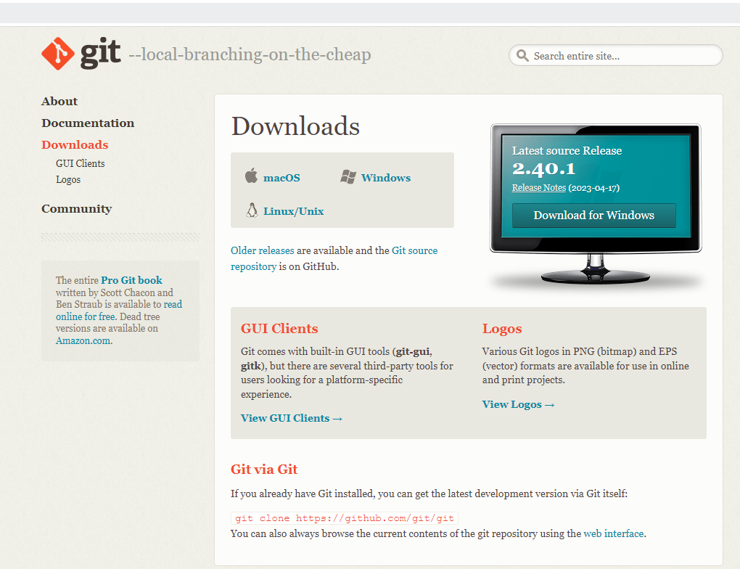
Introduction to GitHub
Lesson 2
Setup Git For Windows
Step 1: Go to
https://git-scm.com/downloads
Step 2:
Select “Download for Windows”

Slide 19
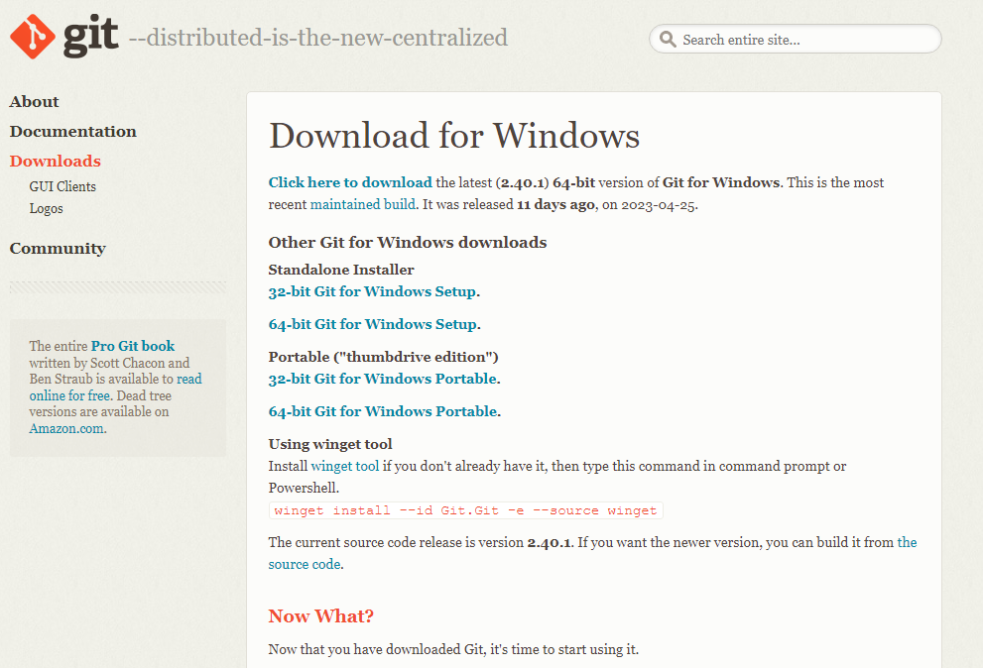
Introduction to GitHub
Lesson 2
Setup Git For Windows
Step 3:
Select 64-bit Git for Windows Setup
Step 4:
Run “Git 2.40.1-64-bit.exe”

Slide 20
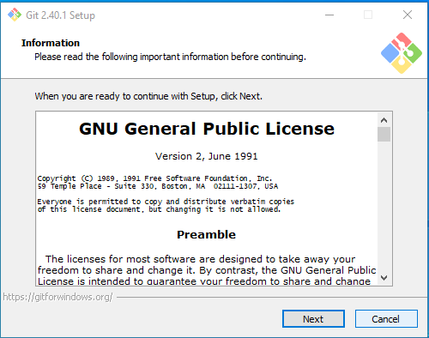
Introduction to GitHub
Lesson 2
Setup Git For Windows
Step 5:
Click Next
Continue clicking Next on each window

Slide 21
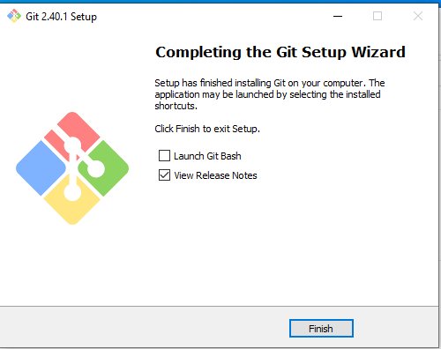
Introduction to GitHub
Lesson 2
Setup Git For Windows
Step 6: Congratulation!!! You have successfully install Git
Click Finish

Slide 22
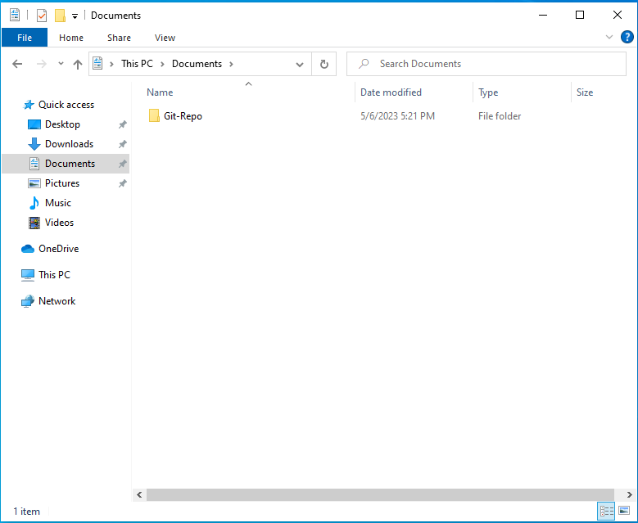
Introduction to GitHub
Lesson 2
Clone Git Repository
Step 1:
Create Git-Folder in the Documents Folder

Slide 23
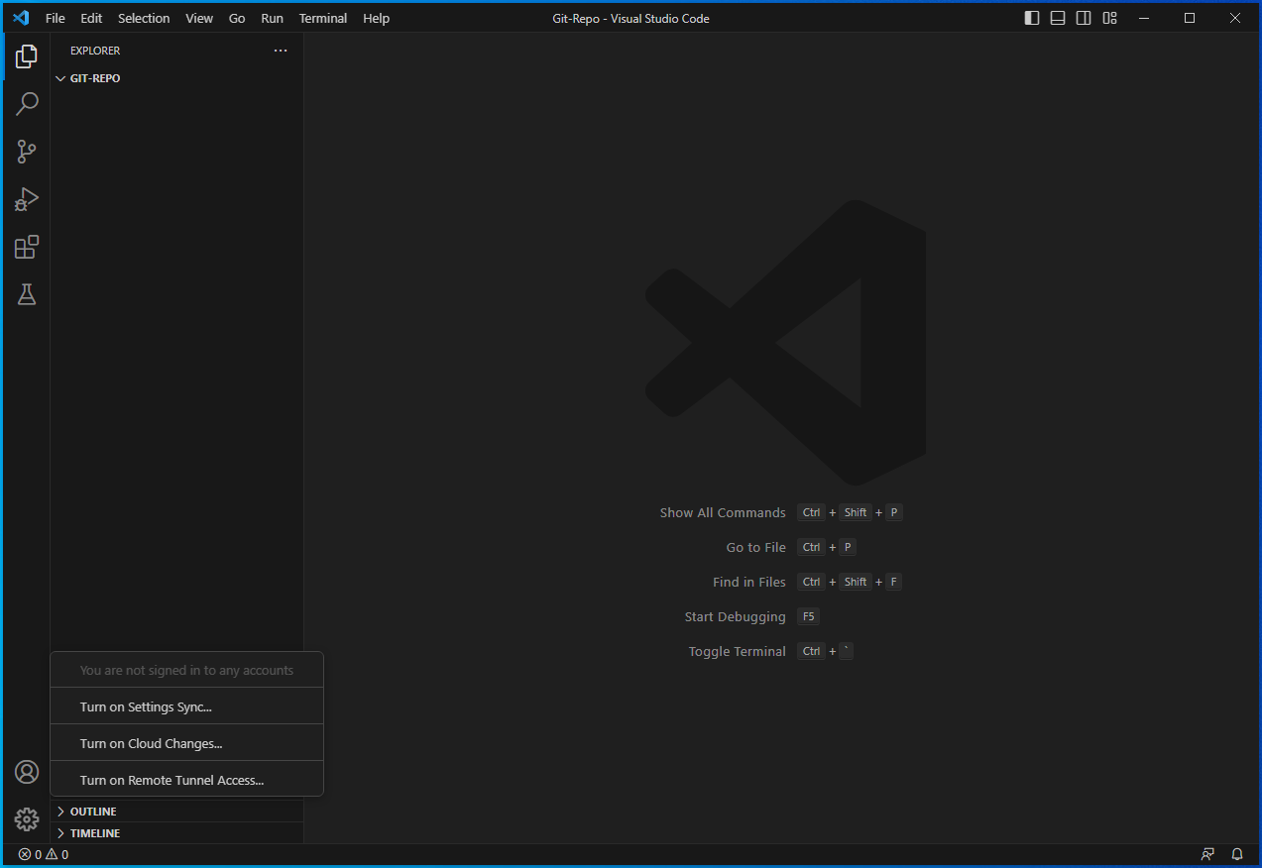
Introduction to GitHub
Lesson 2
Clone Git Repository
Step 2:
Open VS Code
Step 2:
Click Accounts icon
Step 3:
Click “Turn on Settings Sync”

Slide 24
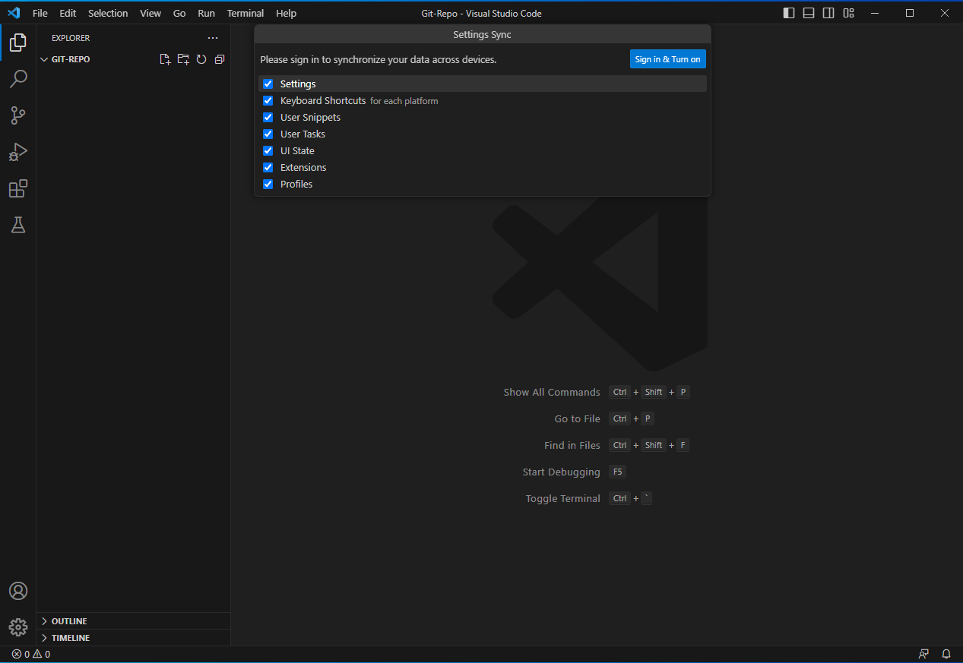
Introduction to GitHub
Lesson 2
Clone Git Repository
Step 4:
Click “Sign in & Turn On”

Slide 25
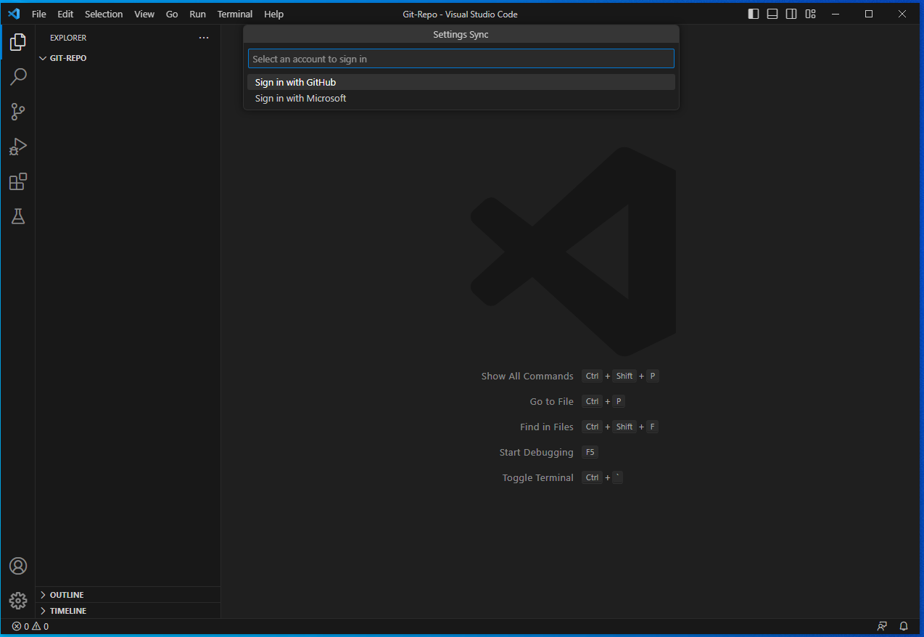
Introduction to GitHub
Lesson 2
Clone Git Repository
Step 5:
Click “Sign in With GitHub”

Slide 26
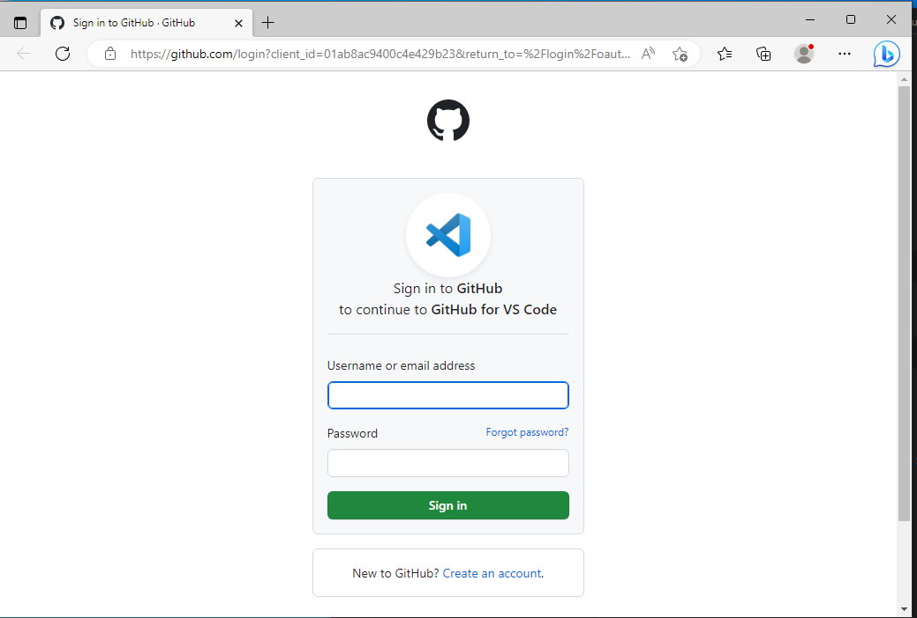
Introduction to GitHub
Lesson 2
Clone Git Repository
Step 6:
Sign in with your email and Password for GitHub

Slide 27
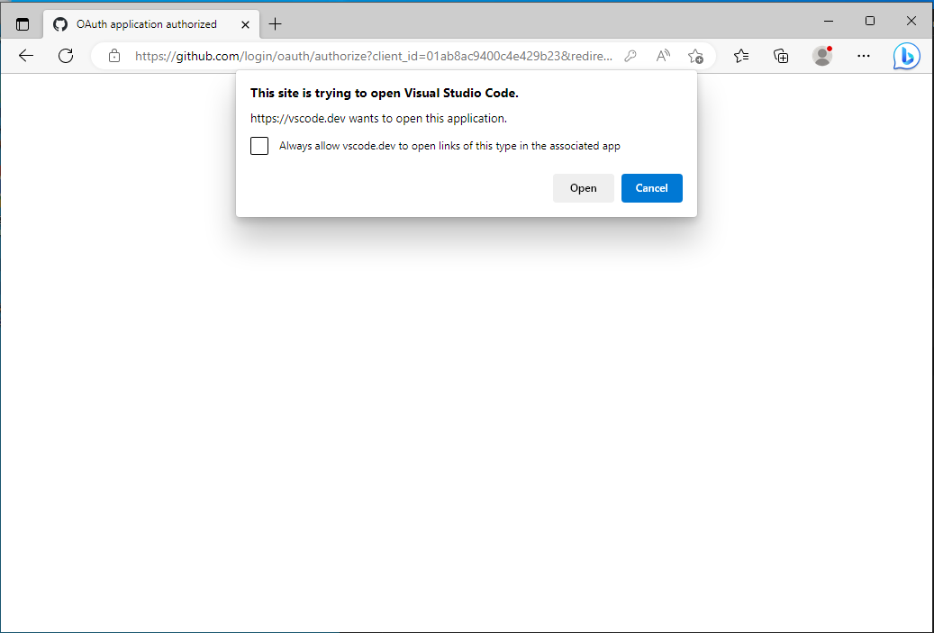
Introduction to GitHub
Lesson 2
Clone Git Repository
Step 7:
Click “Open”

Slide 28
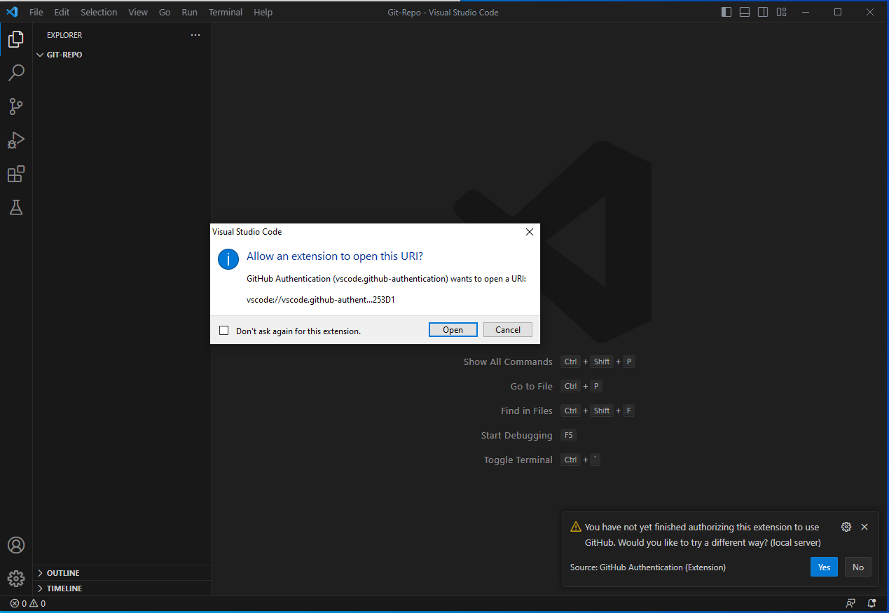
Introduction to GitHub
Lesson 2
Clone Git Repository
Step 8:
Click “Open”

Slide 29
Introduction to GitHub
Lesson 2
Clone Git Repository
Step 9:
Click “Open”

Slide 30
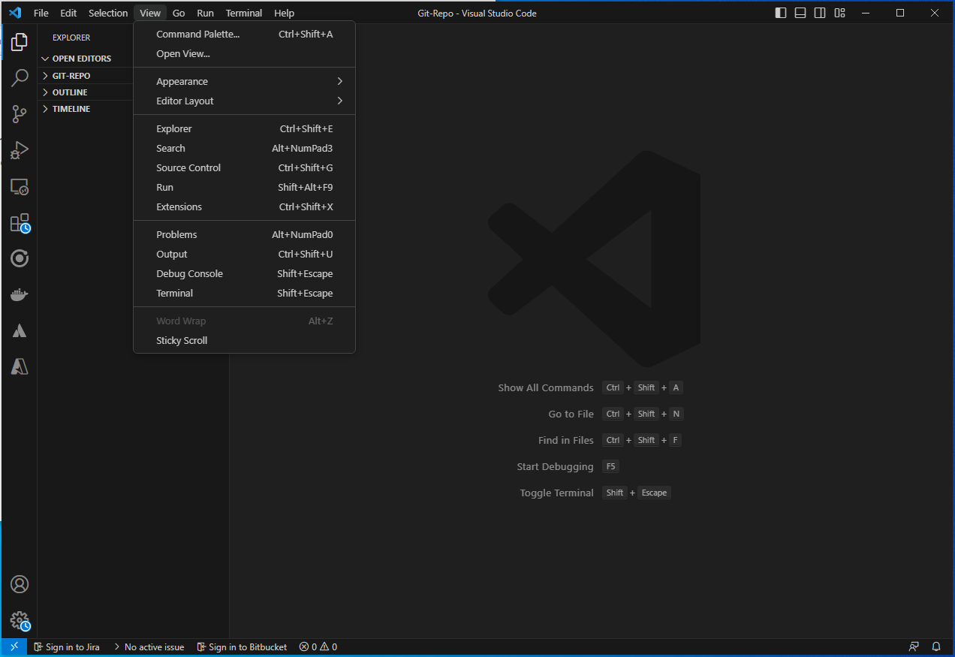
Introduction to GitHub
Lesson 2
Clone Git Repository
Step 10:
Click “View” on menu
Step 11:
Click “Command Palette..”

Slide 31
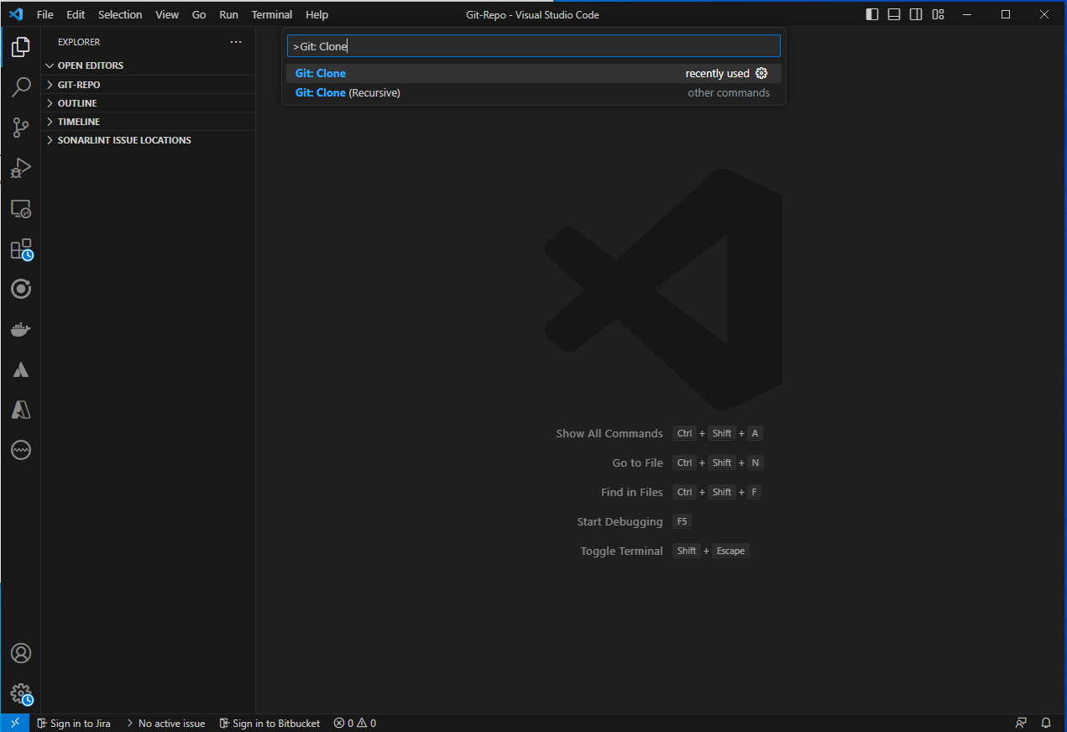
Introduction to GitHub
Lesson 2
Clone Git Repository
Step 12:
Search “Git:Clone” on menu
Step 13:
Select “Git Clone”

Slide 32
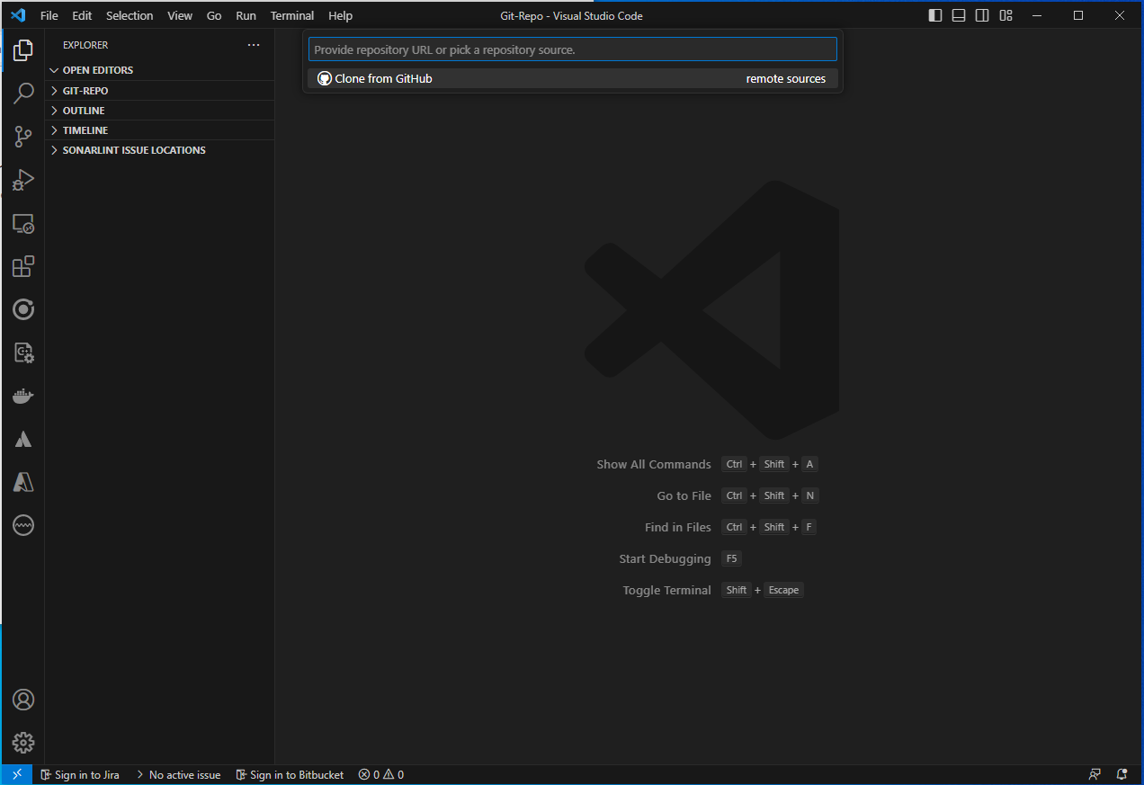
Introduction to GitHub
Lesson 2
Clone Git Repository
Step 14:
Select “Clone from GitHub”

Slide 33
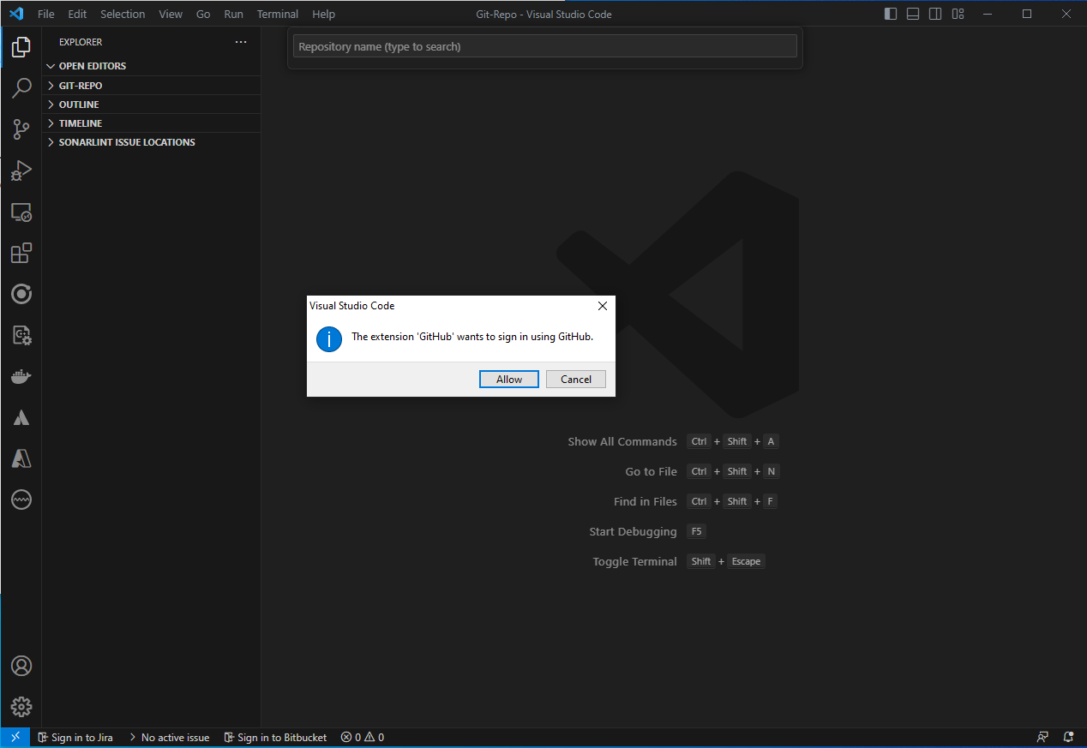
Introduction to GitHub
Lesson 2
Clone Git Repository
Step 15:
Select “Allow”

Slide 34
Introduction to GitHub
Lesson 2
Clone Git Repository
Step 16:
Select “Allow”

Slide 35
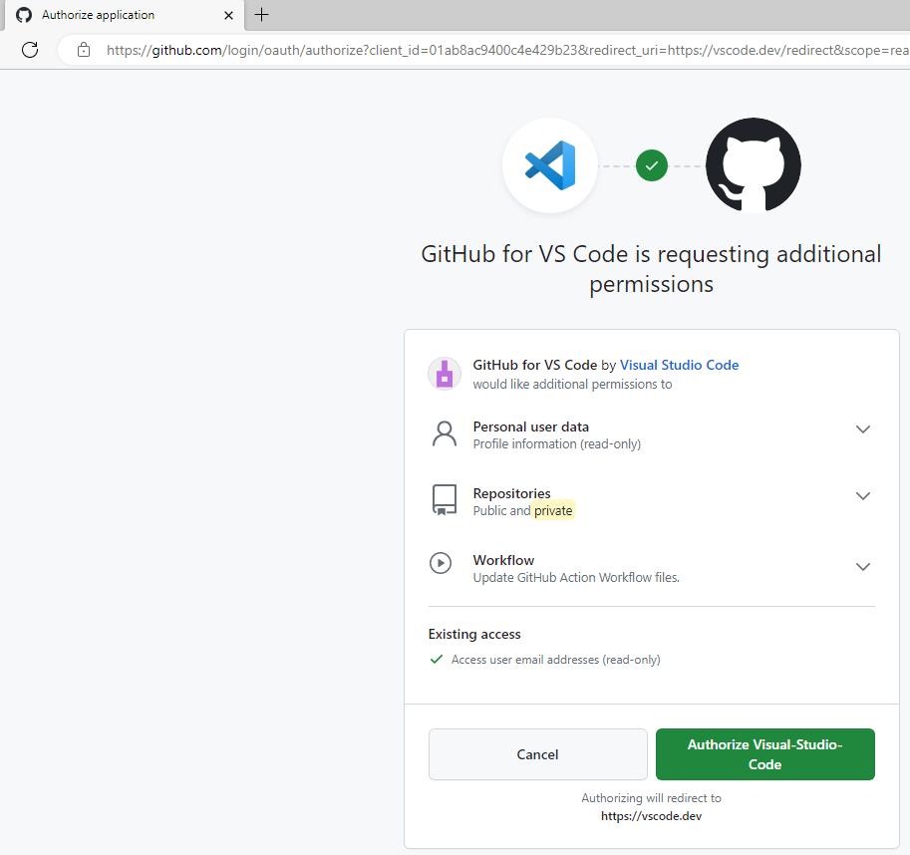
Introduction to GitHub
Lesson 2
Clone Git Repository
Step 17:
Click “Authorize Visual Studio-Code”

Slide 36
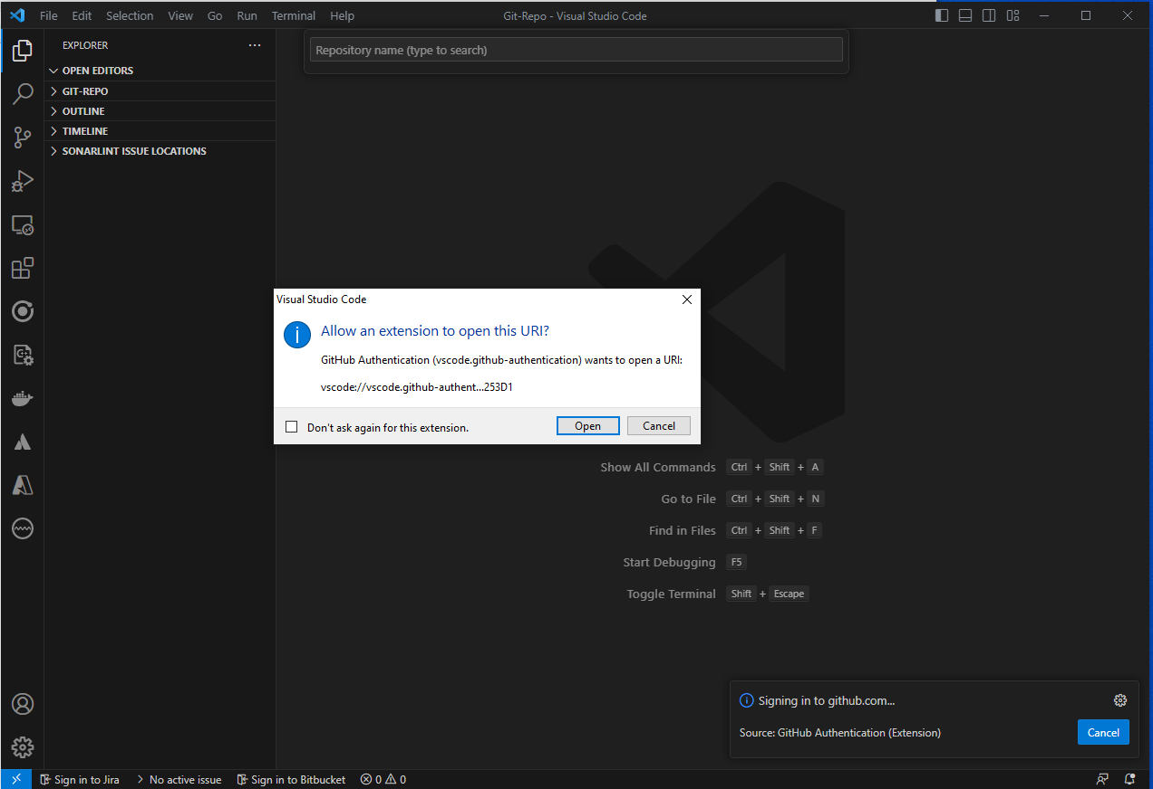
Introduction to GitHub
Lesson 2
Clone Git Repository
Step 18:
Click “Open”

Slide 37
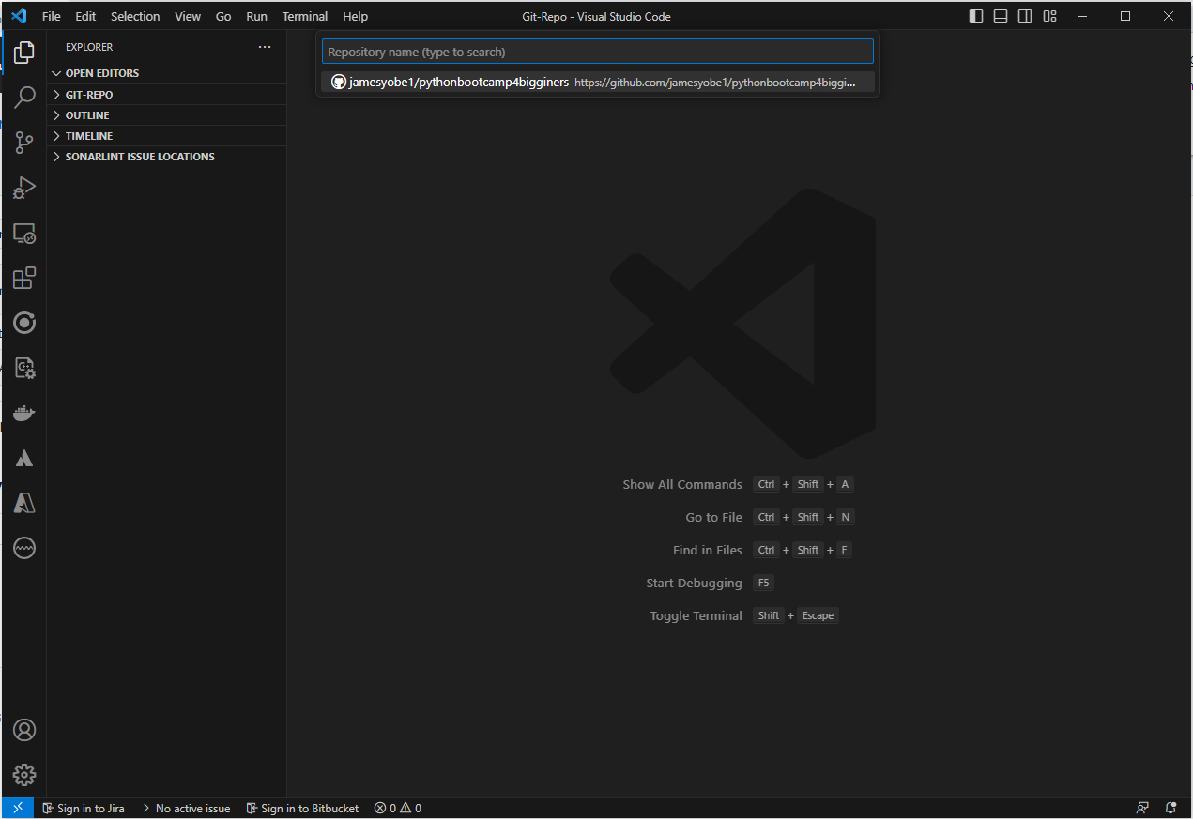
Introduction to GitHub
Lesson 2
Clone Git Repository
Step 19:
Click “Select your GitHub repository”

Slide 38
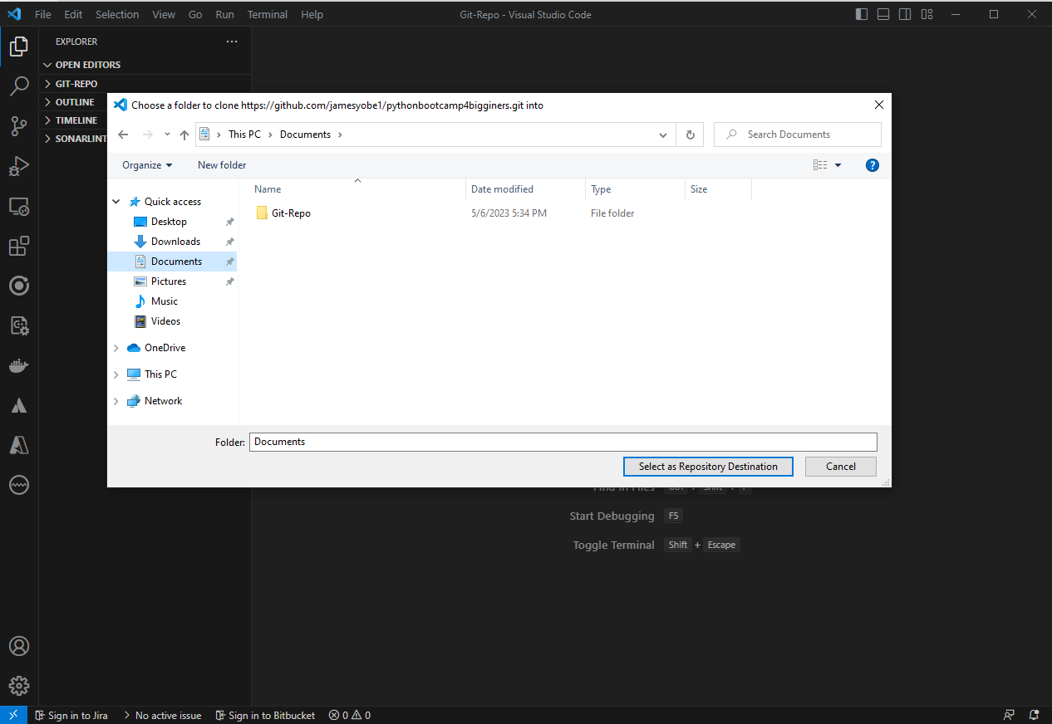
Introduction to GitHub
Lesson 2
Clone Git Repository
Step 20:
Select “Git-Repo” in your documents folder

Slide 39
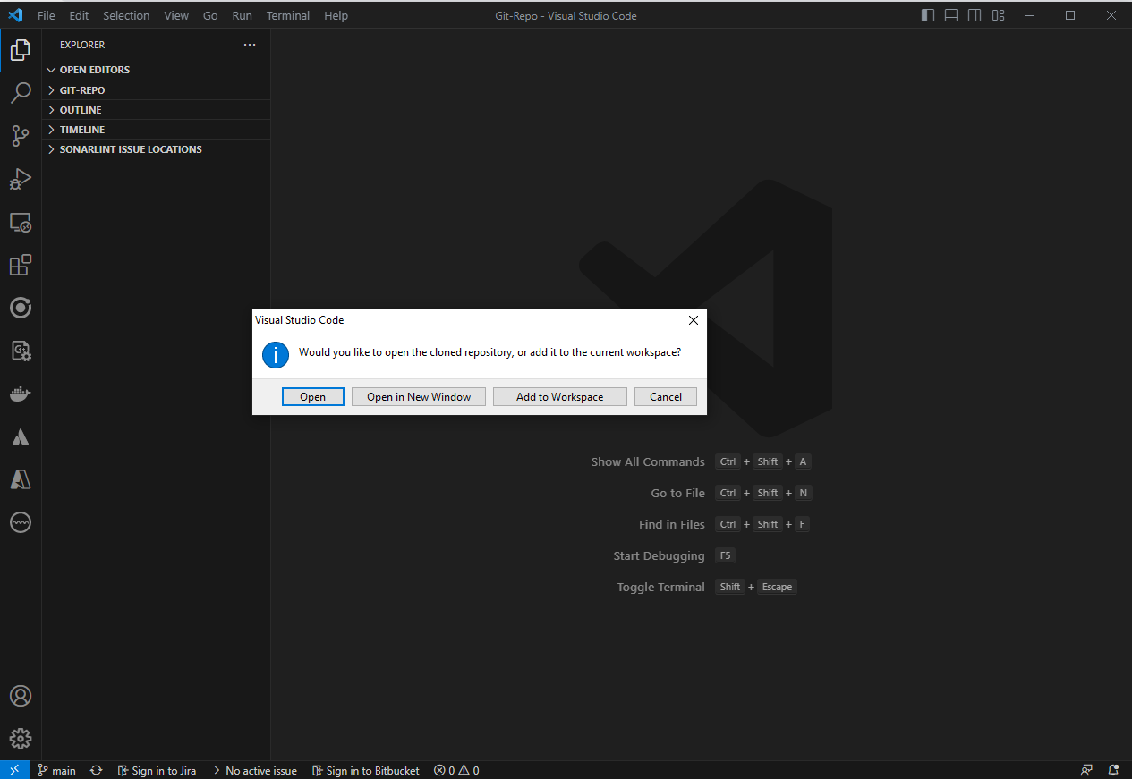
Introduction to GitHub
Lesson 2
Clone Git Repository
Step 21:
Select “Open”

Slide 40
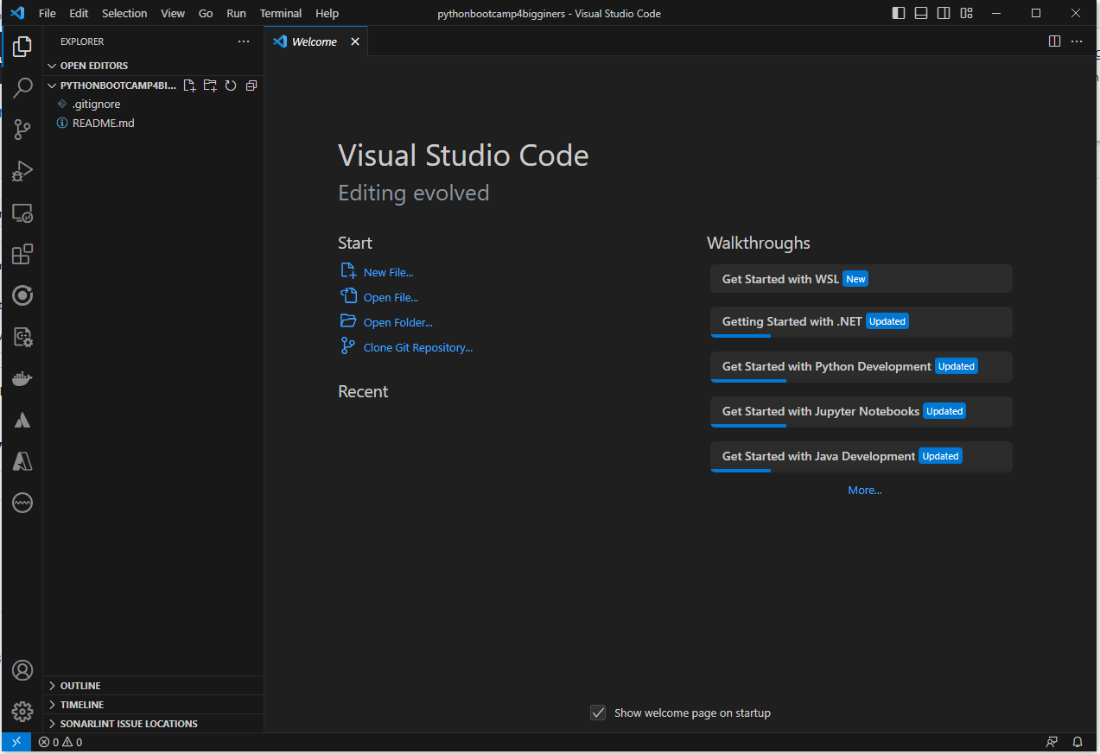
Introduction to GitHub
Lesson 2
Clone Git Repository
Step 22:
Congratulation!!! You have successfully cloned your GitHub Repository to your computer

Slide 41
Practice & Question
Lesson 2
Hello World
Create App.py in App/Hello_World folder
Print Your name
Create App.py in App/Name folder
Add 2 Numbers
Create App.py in App/Numbers folder
Print “Python is awesome”
Create App1.py in App/ Python_is_awesome folder
Print “Python is awesome” where each word is stored in a different variable
Create App2.py in App/ Python_is_awesome folder
Find Average of 5 numbers
Create App.py in App/Average_Of_5_numbers folder

